Slide 1
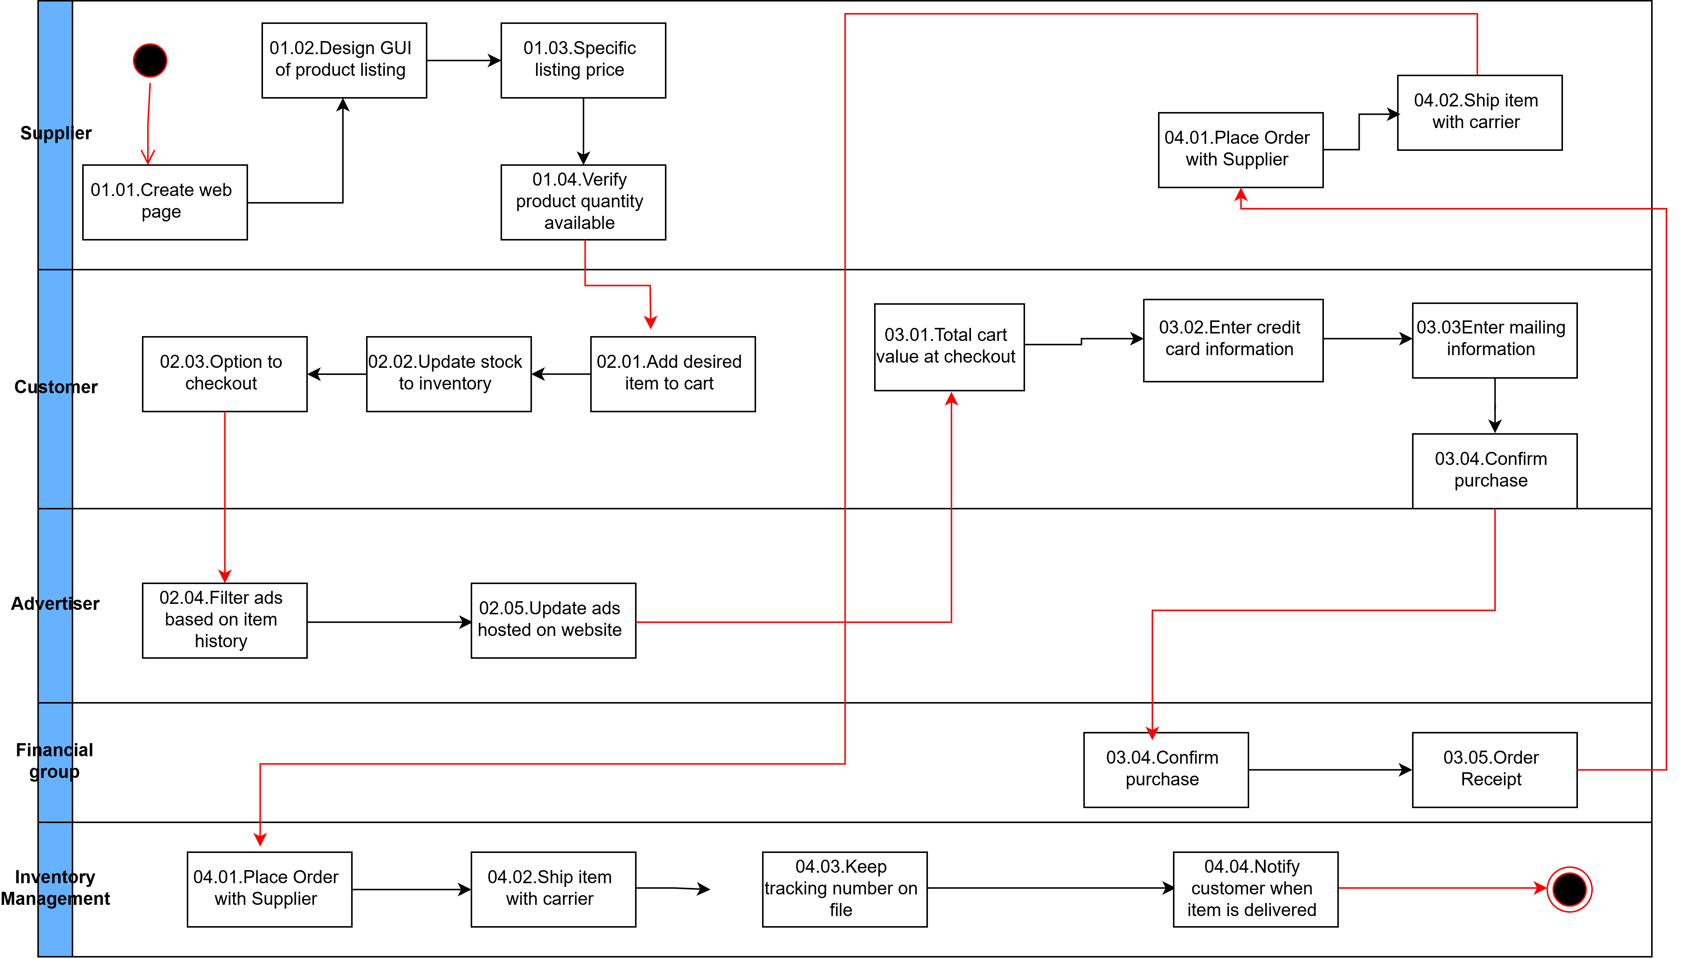
UML ACTIVITY DIAGRAM

